Slide 1
Drilling Down
Analyzing Literacy Data of Struggling Students
Debbie Fleming
debbie.fleming@arkansas.gov
Robin Stripling
robin.stripling@arkansas.gov
AR State Personnel Development Grant

Slide 2
Housekeeping
Sharing Space
Take Care of Your Needs
Breaks and Lunch
Cell Phone Use
Respect the Group

Slide 3
Objectives for the Day
Analyze student performance data through a systematic approach using the data-based problem solving process and a charting method.
Drill down into the data to get additional information for a clearer idea of where students’ problems lie.
Use student data as a basis for making instructional decisions to meet the needs of struggling students.
Access and use web-based tools and other research-based resources to determine strategies and interventions for literacy instruction.

Slide 4
DRIP Syndrome
Data Rich but Information Poor
Richard DuFour

Slide 5
For struggling readers, just making progress
isn’t good enough!
Benchmark 1
Benchmark 2
Benchmark 3
Established - Benchmark
Score
Emerging - Strategic
Deficit - Intensive
Time
Notes:
5
36

Slide 6
Putting It All Together
Curriculum
“What we teach”
Instruction
“How we teach”
Assessment
“Guides the process”

Slide 7
When curriculum, instruction, and
assessments are working together…
Benchmark 1
Benchmark 2
Benchmark 3
Established - Benchmark
Score
GOAL:
Close the gap!
Time
Notes:
7
36

Slide 8
Arkansas’ Closing the Achievement Gap
Organizational Model For Maximizing Student Achievement
DATA DRIVEN LEADERSHIP
Curriculum, Instruction, and Assessment
Behavior, Discipline, Climate
CORE CURRICULUM
S
P
R
I
N
T
Academic Instruction & Intervention
Behavioral Instruction & Intervention
Parent and Community Outreach
Professional Development, Mentoring
“CTAG”
Notes:
8

Slide 9
What is the Arkansas RtI Model? Closing the Achievement Gap “CTAG”
The practice of:
providing high-quality instruction/intervention matched to student needs and
using learning rate over time and level of performance to
make important educational decisions.

Slide 10
Problem-Solving Process??
What’s the problem?
This is what I will try.
Intervention Roulette
Notes:
c- Knoff Project ACHIEVE, 2006 SPRINT Process
10

Slide 11
Problem-Solving Process!!
Problem Identification:
WHAT?
Problem/Functional Analysis: WHY?
Strategic Intervention:
HOW?
Formative & Summative Evaluation:
DID IT WORK?
Notes:
c- Knoff Project ACHIEVE, 2006 SPRINT Process
11

Slide 12
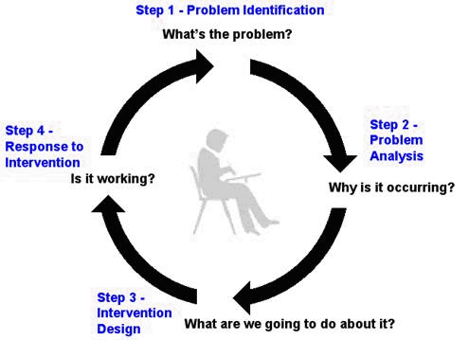
Data-Based Problem Solving Process and RtI²

Slide 13
No competent physician would attempt to diagnose a problem or prescribe a possible treatment based on a single assessment.

Slide 14
Literacy Implementation Guidance for the ELA
Summary of Recommendations for Diverse Learners:
The CCSS require equal outcomes for all students, but they do not require equal inputs. Vary the amounts and types of instruction provided to students to ensure high rates of success.
Monitor student learning and provide adjustments and supplements based on that information.

Slide 15
Big Ideas in Beginning Reading
Phonemic
Awareness
Fluency
Vocabulary
Comprehension
Phonics

Slide 16
Educators as Physicians
“Let’s see what’s
going on…”
Assessments targeted to specific skills

Slide 17
Dig a Bit Deeper
Collect additional data to pinpoint what instructional assistance will most appropriately meet each student’s needs.
Use skill-specific diagnostic assessments.
Use quick, informal measures.
These are not to diagnose a specific disability.

Slide 18
What We Know and What We Still Need to Investigate
Based on the ORF analysis, we know the student has decoding needs within connected text.
Question: Does the student have decoding needs at the word level?
Let’s Dig Deeper
Notes:
18

Slide 19
Teach and Assess Along the Continuum
Accuracy/Decoding Instruction
Letter & Letter-Sound Correspondence
Word Level
Phrase Level
Connected Text
List of errors from error analysis
Error analysis
Phonics assessments
Notes:
19

Slide 20
Investigate Decoding Skills
Error analysis on Informal Reading Inventory
(IRI) and/or ORF passages
Quick Phonics Screener – QPS
Stand alone phonics/decoding assessment

Slide 21
Possible Assessments
IRI/Informal Reading Inventory/DRA/WRAP
QPS/Quick Phonics Screener
DSA/Developmental Spelling Analysis
ORF/Oral Reading Fluency
NWF/Nonsense Word Fluency
PSF/Phoneme Segmentation Fluency
Writing Sample
Sight Word Recognition
CSA/Comprehension Strategy Assessment

Slide 22
The Five Big Ideas
Phonemic Awareness
Detecting Rhymes
Counting Syllables
Matching Initial Sounds
Comparing Word Lengths
Representing Phonemes with Letters
Phonics
QPS-Quick Phonics Screener

Slide 23
The Five Big Ideas
Fluency
Reading Rate Fluency Rubrics
Accuracy Descriptive
Speed Rating Scale
NAEP’s Oral Reading Fluency Scale
Multidimensional Fluency Scale

Slide 24
The Five Big Ideas
Vocabulary
San Diego Quick Assessment
Harris and Jacobson Word List
Fluency Phrases
Fry Sight Word List
Comprehension
DIBELS ORF/Retell
DRA/WRAP
3 Minute Reading Assessment
Questioning

Slide 25
If a student reads a paragraph and cannot correctly answer related questions, it is difficult to discern:
Is it because she doesn’t understand the key vocabulary words used?
If so, is that because she is not a native speaker of English?
Or has she simply had limited exposure to those words?
Or does she have a cognitive deficit in language processing?
Or perhaps she had difficulty simply reading the words with sufficient accuracy?
Did she read the paragraph with poor fluency?
Or has she not mastered some key comprehension strategies such as recognizing story structure or metacognition?
Or is she having difficulty with her short-term memory?
Jan Hasbrouck, Ph.D.

Slide 26
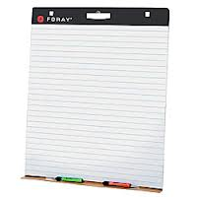
Charting Student Data

Slide 27
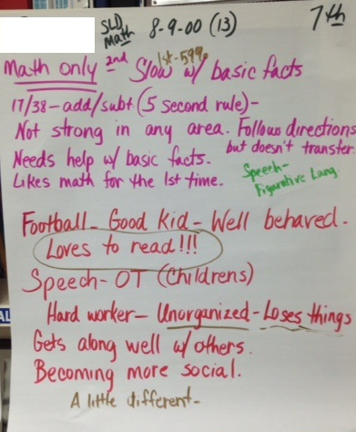
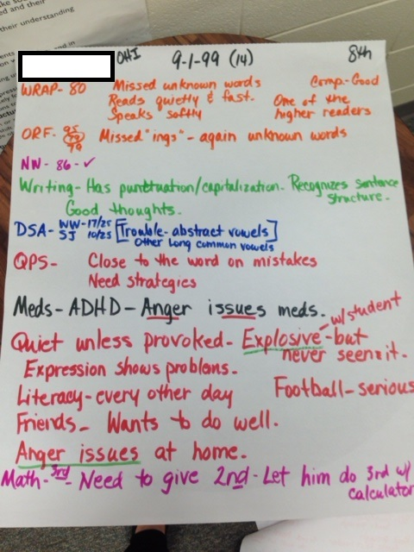

Slide 28
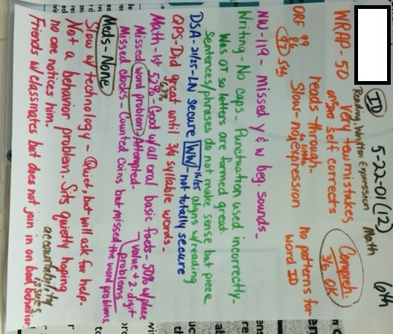
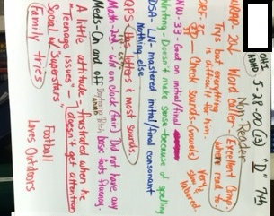

Slide 29
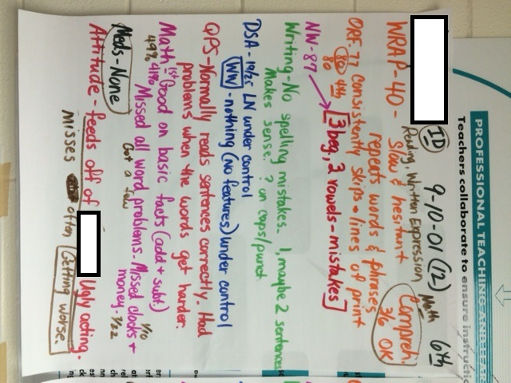
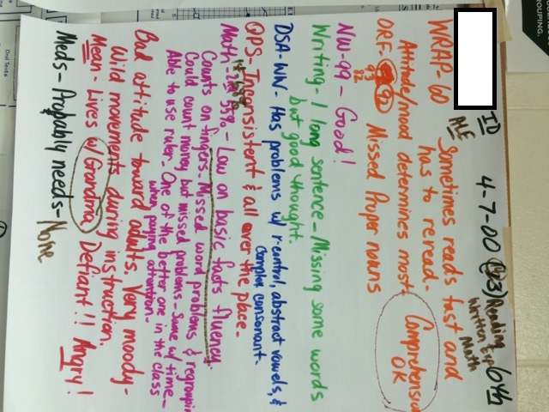

Slide 30
Instructional Needs of Students
Most educators agree that more effective instruction can be provided when the group of students is small and the students are grouped according to similar instructional needs.

Slide 31
Organizing Data
Organizing data based on performance(s) assists in grouping students for instructional purposes.

Slide 32
Organizing Fluency Data: Making the Instructional Match
Group 1: Dig Deeper in the areas of reading comprehension, including vocabulary and specific comprehension strategies.
Group 2: Build reading fluency skills. (Repeated Reading, Paired Reading, etc.) Embed comprehension checks/strategies.
Group 3: Conduct an error analysis to determine instructional need. Teach to the instructional need paired with fluency building strategies. Embed comprehension checks/strategies.
Group 4: If student can correct error easily, teach student to self-monitor reading accuracy. If reader cannot self-correct errors, complete an error analysis to determine instructional need. Teach to the instructional need.
Group 1: Accurate and Fluent | Group 2: Accurate but Slow Rate
Group 3: Inaccurate and Slow Rate | Group 4: Inaccurate but High Rate
Self-monitor accuracy
Notes:
32

Slide 33
Group 3
Group 1: Accurate and Fluent | Group 2: Accurate but Slow Rate
Group 3: Inaccurate and Slow Rate | Group 4: Inaccurate but High Rate
Sight Word Needs
Basic Decoding Needs
Multi-syllabic Decoding Needs
Notes:
33

Slide 34
How About a “Combo”
Try doing a combination of fluency level work…
For example: A student is accurate but slow on sight words and is both accurate and slow in connected text.
“COMBO” 2-5 minutes of drill work on sight words
in isolation, AND 5-10 minutes of work in phrase
strips or connected text using those sight words.
Adding the “quick” drill work opportunities, as often
possible, is a great way to intensify instruction.
Notes:
34

Slide 36
The teacher and/or team
should not assume that
the instructional adjustments
will work
but should use
student performance data
to make this determination.

Slide 37
Chart Maker
“Charting the Course for Success”
Electronic charting tool
Monitor academic & behavioral
progress
Help make instructional
decisions

Slide 38
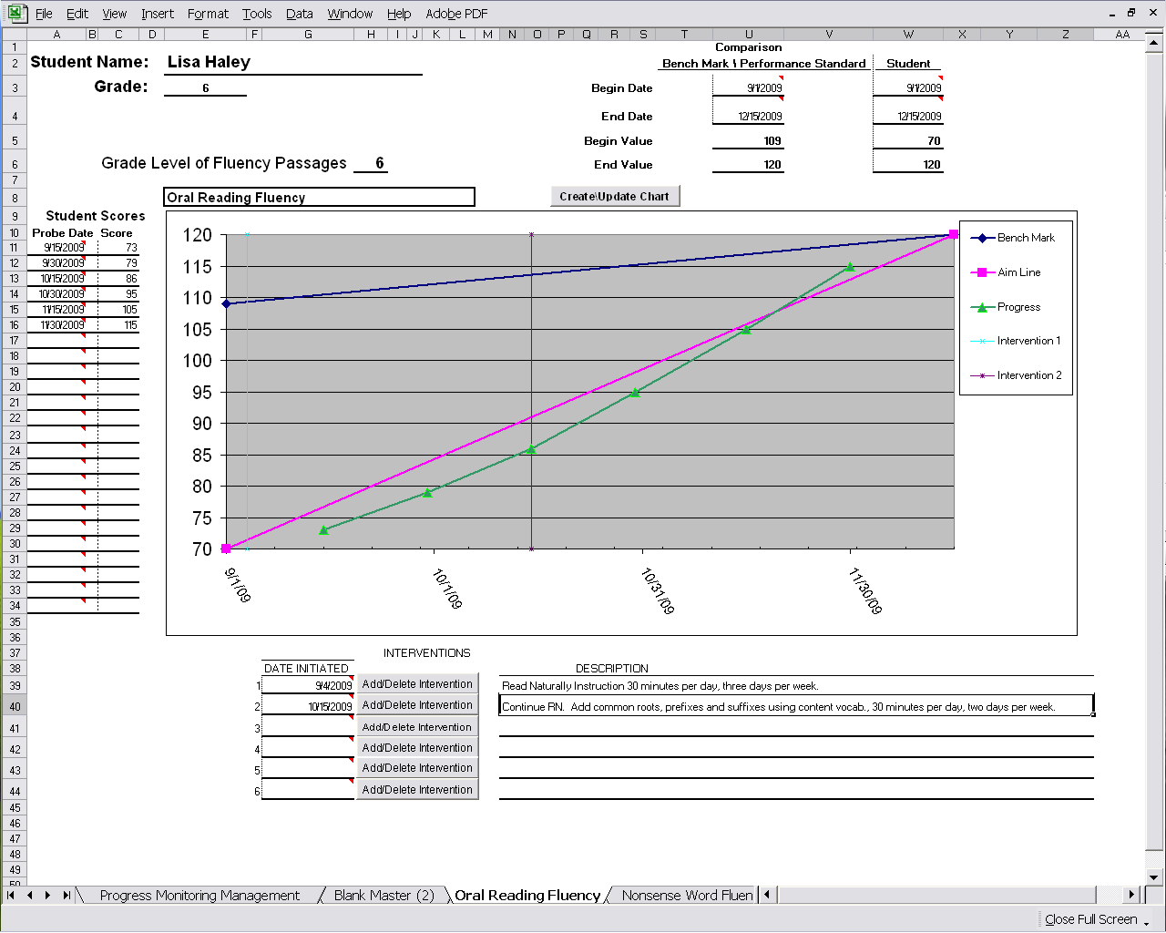

Slide 39
www.arstudentsuccess.org
Notes:
c- 2009 Project ACHIEVE Press
39

Slide 40
Tier II & III Literacy Interventions for K-12
Student Assessment Questions
about individual students
Instructional tactics in five areas of reading that include:
- Detailed lesson plans
- Graphic organizers or
worksheets
- Video clips
http://ride.sopriswest.com/reading/login.aspx
Notes:
40

Slide 41
http://www.fcrr.org/
Instructional Materials for Teachers
Student Center Activities (K-5)
Alignment to CCSS (Student Center Activities Aligned to the Common Core State Standards)
Empowering Teachers

Slide 42
www.ReadWorks.org
1,000 Non-fiction Passages
Aligned to the Common Core and State Standards
Research-based question sets
Lexile Leveled

Slide 43
Accommodating Diverse Learners
The key to a successful accommodation is to match resources to a student’s developmental level and provide opportunities for practice with a purpose. Learning A-Z’s websites provide leveled PreK-6 resources for full class to small group to individual practice and one-to-one interventions.
WritingA-Z.com
ReadingA-Z.com
VocabularyA-Z.com
ScienceA-Z.com
Raz-Kids.com
Reading-Tutors.com

Slide 44
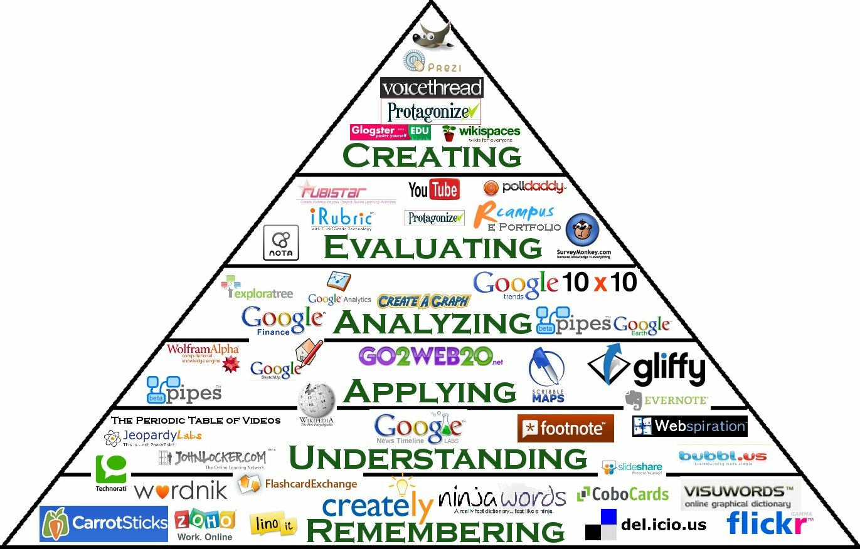
Bloom’s Digital
Taxonomy
Pyramid
Samantha Penney

Slide 45
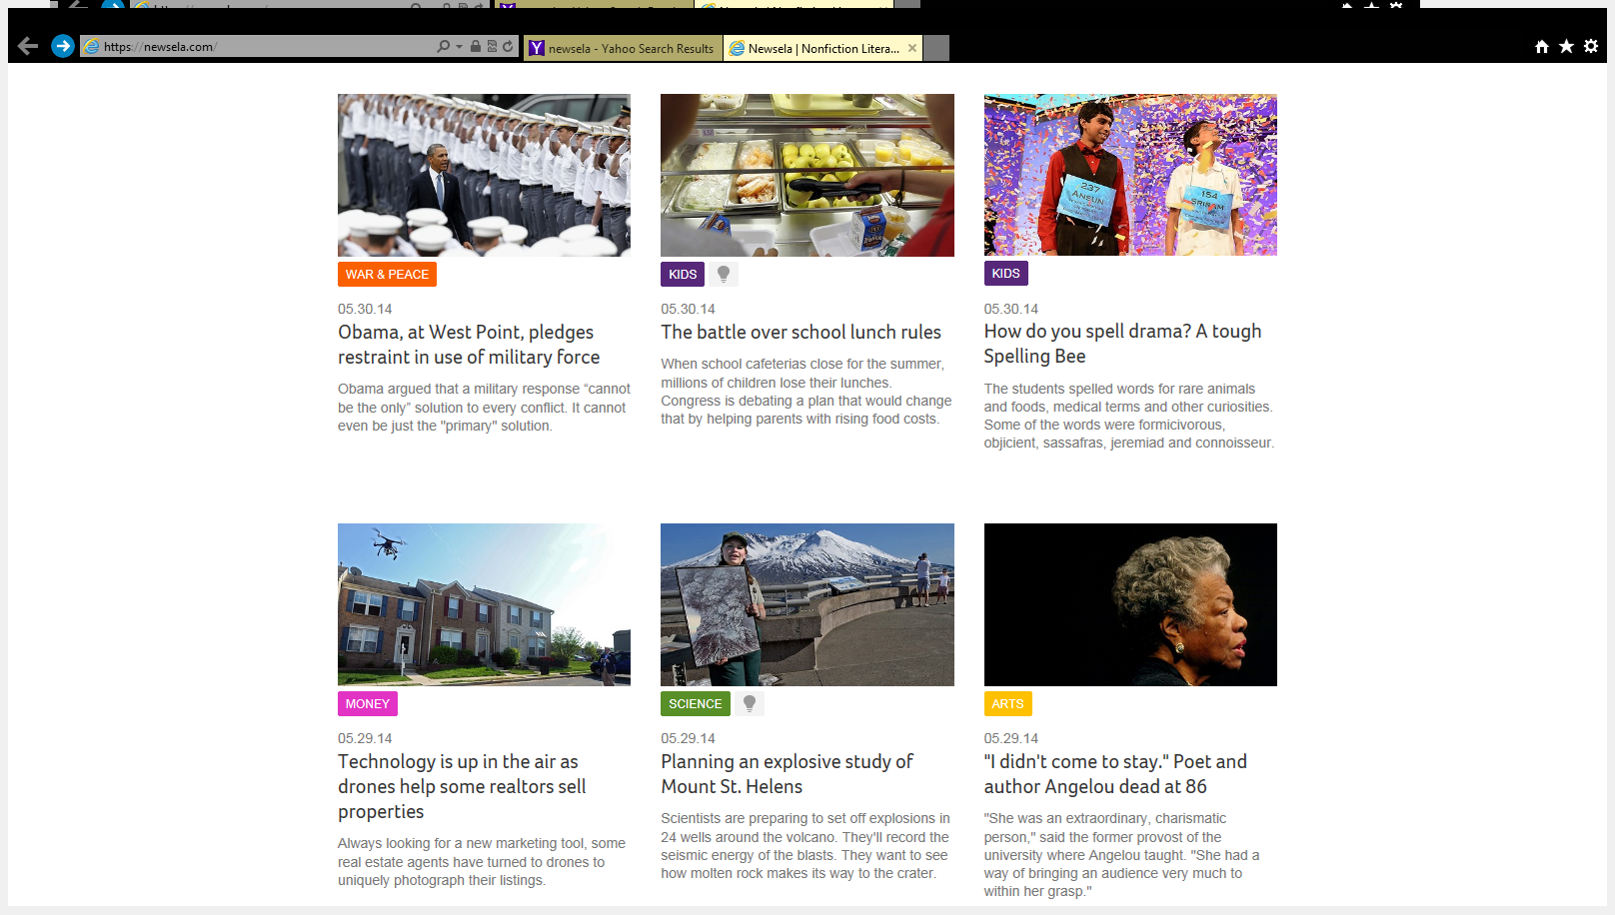
NEWSELA

Slide 46
Britannica

Slide 47
National Geographic Explorer

Slide 48
Brain Break
Talk with your elbow partner for one minute about how you will use data to guide your instruction. On your phone or electronic device, go to the tinyurl address and share your answer.
http://tinyurl.com/K6412P

Slide 49
Notes:
Poll Title: What assessment are you most likely to use? http://www.polleverywhere.com/multiple_choice_polls/GF9bGwUuzAEGPWt

Slide 50
Internet Resources Supporting Literacy
http://www.literacycenter.net
http://www.readingrockets.org
http://readwritethink.org
http://interventioncentral.org
www.fcrr.org
www.centeroninstruction.org
www.ReadWorks.org
www.learninga-z.com

Slide 51
“My greatest satisfaction comes when my students find the success they never thought that they could have.”
Addie Rhodes Lee

Slide 52
AR SPDG
www.arstudentsuccess.org
Resources can be found at
http://DrillingDownData.weebly.com

